Slide 1
Pick and Remix: Building foundation skills with born-digital OERs
CAUL: Enabling Modern Curriculum Conference
September 7th 2022
Lightning talk
Teryn Attwell
Learning Design Lead (HEPPP)
Digital Learning, Quality and Engagement, RMIT University Library
Notes:
My name is Teryn Attwell, I’m a Learning Designer with the Digital Learning team at RMIT University Library.
Hello everyone, thank you for coming to my online session. Today I’m coming to you from Wurundejeri lands. Over the next seven minutes, I will introduce a project my team has been working on since the beginning of the year which supports learners by providing foundation resources in a flexible, shareable, born-digital format.

Slide 2
Project Overview
Learning Lab Contextualised Content Project (LLCC)
Multi-disciplinary suite of open education resources (OERs) – available in December 2022.
Funded by the DESE - Higher Education Participation and Partnership Program (HEPPP)
Aims to build aspiration and widen access to higher education.
Supports learners who identify as:
from regional and remote Australia
Aboriginal and Torres Strait Islander
from low SES backgrounds.
We are developing an interactive digital environment connecting learners to support material on RMIT’s Learning Lab.
Notes:
The Learning Lab Contextualised Content project (LLCC) is a multi-disciplinary suite of open education resources which will be available to learners, teachers and librarians everywhere from December.
The project is funded by the DESE's Higher Education Participation and Partnership Program (HEPPP) which aims to build aspiration and widen access to higher education in specific equity groups.
Our team is contributing to this goal by developing an interactive digital environment full of contextualised learning objects which will connect learners, especially those from the HEPPP groups, with the existing wealth of digital support material available on the Library’s Learning Lab section.

Slide 3
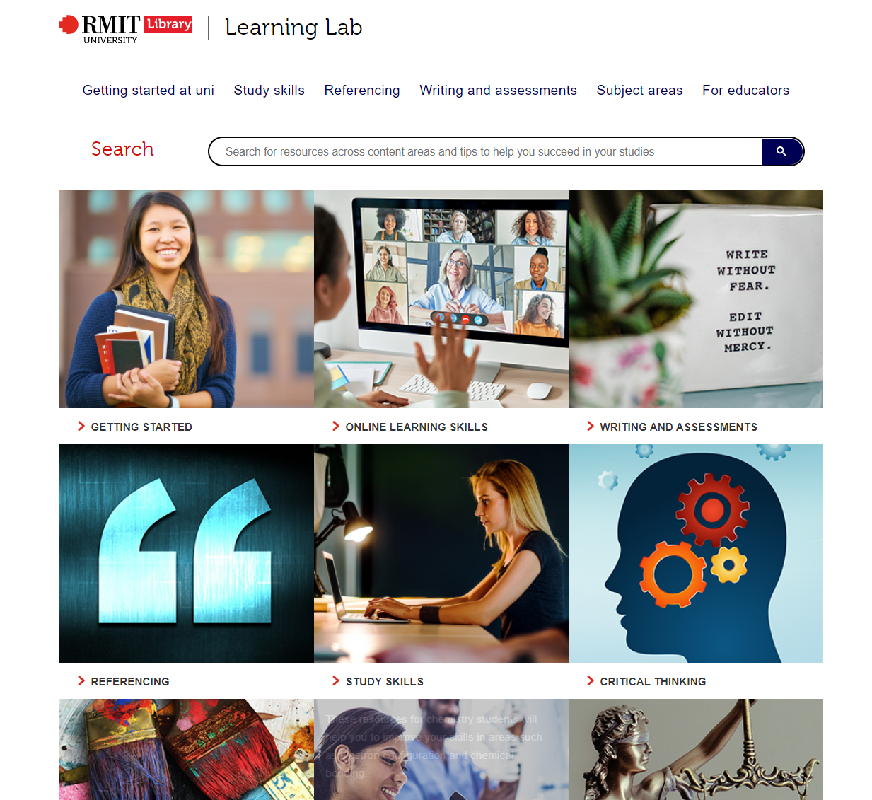
Learning Lab
An existing RMIT Library resource providing foundation skills and study support materials.
Learning Lab material is primarily accessed by:
users actively searching for materials on specific topics
students linked to materials by course tutors or support staff.
Notes:
Learning Lab is a digital RMIT resource which is managed by the library.
It provides skills and study support materials in a range of subject areas including writing, maths, and critical thinking, as well as soft skills like collaboration and time management.
The material on Learning Lab is primarily accessed by users who are already actively seeking more information on a particular topic, or current students who are guided there by library staff or their course tutors. So, our project team saw an opportunity.

Slide 4
Contextualised content
We saw an opportunity for the library to reach and engage the HEPPP cohorts
Relevant, real-world examples
Industry-focused content
Practical application of skills and knowledge
Contextualised material to reach more potential learners
More information in Azadeh Mobahseri’s talk ‘ Addressing inequity with shareable resources’.
Notes:
We saw opportunity to create a way to reach a larger audience for the Learning Lab, and engage potential higher ed students, particularly those in the HEPPP cohorts.
The LLCC environment includes more real-world examples, industry-focused material, and content showing that skills on Learning Lab are transferable and can be practically applied in everyday life.
We spent the initial stages of the project researching, mapping, and aligning the content to the needs of the cohorts, and my colleague, Azadeh Mobasheri, will be covering this in her own talk later in this session.

Slide 5
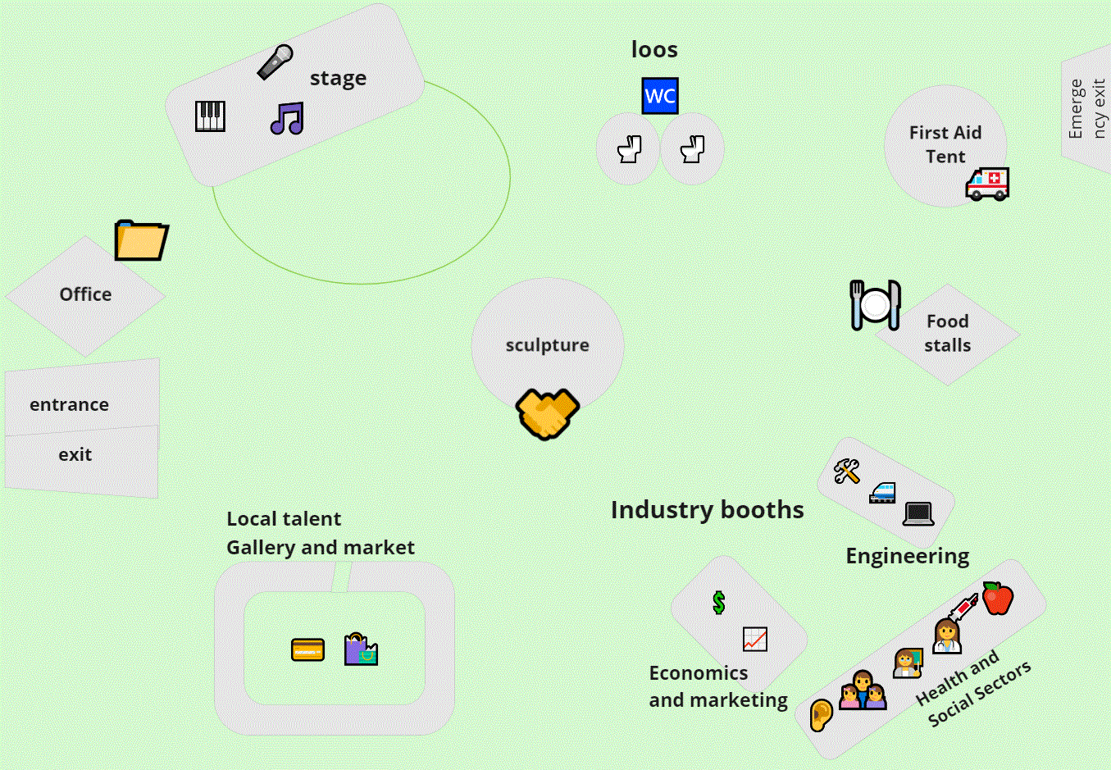
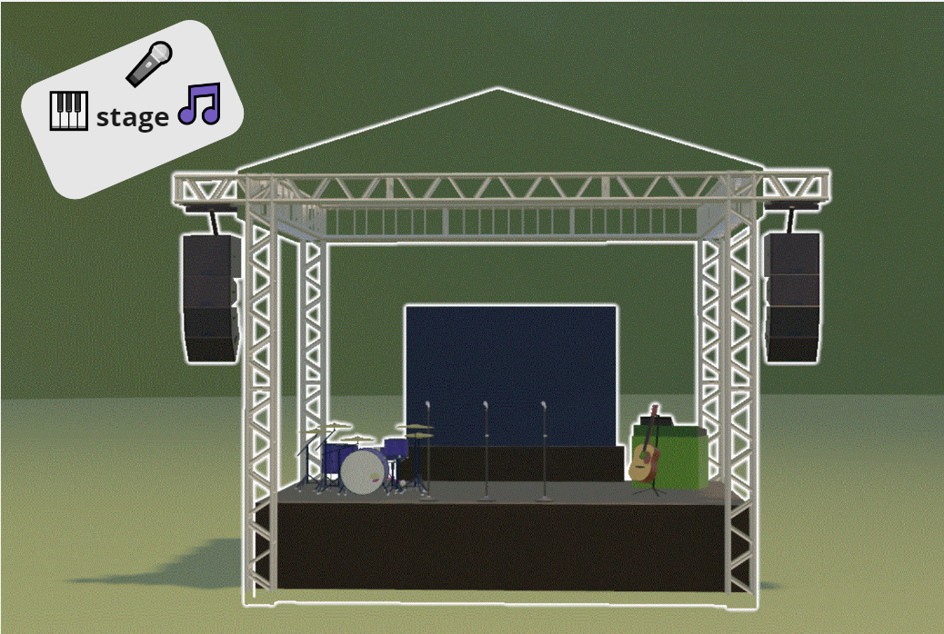
Okay, but what is it?
Welcome to the Salty Creek Festival Map
An interactive 3D festival map
Mock-up image
Notes:
It’s an interactive 3D learning environment, contextualised as a regional festival in the fictional town of Salty Creek.
Learners can follow the activities of the six characters in the festival planning team as they go about organising and setting up the festival.
Organising a large-scale event, like a festival, requires a host of skills such as writing to stakeholders, collaborating with colleagues, solving problems with critical thinking, and using maths skills to balance the budget.

Slide 6
Okay, but what is it?
Welcome to the Salty Creek Festival Map
An interactive 3D festival map
Patient Treatment and Critical Thinking object
1. Learners access the map and select an object to explore.
Notes:
Learners can access the map and select objects which interest them. For example, an object on critical thinking in nursing.

Slide 7
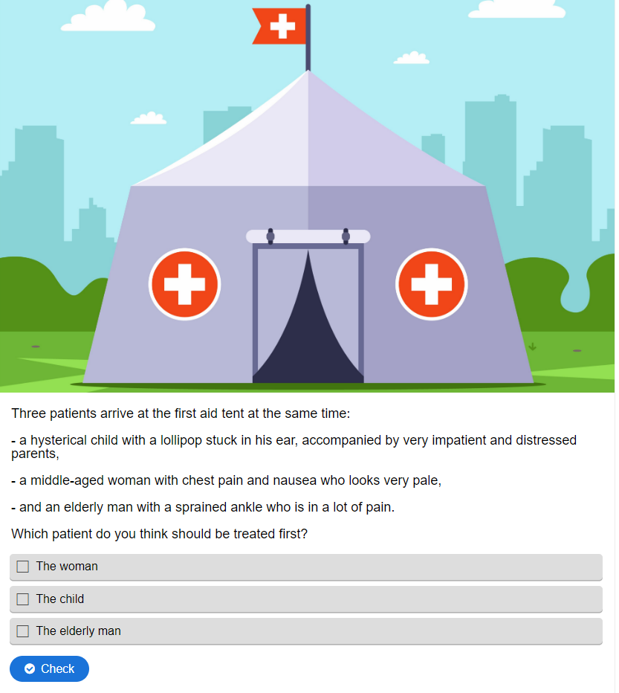
Okay, but what is it?
Modular Learning Object
2. They read the contextualised scenario and interact with the content.
quiz with feedback
contextualised scenario
Notes:
They are taken to a contextualised scenario and are able to interact with the content.

Slide 8
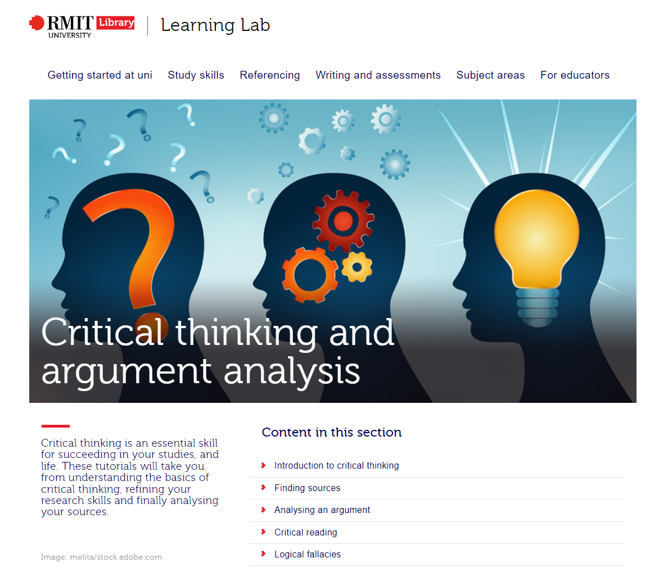
Okay, but what is it?
Connected to Learning Lab resources
3. They can choose to stay on the festival map or learn more on Learning Lab.
Follow links to more in-depth information on Learning Lab
Notes:
Then, they can stay within the map environment, or continue to the existing material on the Learning Lab platform if they are inspired to learn more about the topic.

Slide 9
Pick and Remix
Lo-fi and off-line access
Not everyone has equal access to reliable Wi-Fi
Interactive map environment and Pressbooks textbook
Lo-fidelity versions of this material will be available
Modular objects and open use
Learners can focus on one area/can be guided to the area they need
Completely open source: using H5P and CC media
Modular objects (are not dependent on other objects)
Educators can pick and remix modular objects or themed series of objects
Suitable for use in online, in-person, hybrid, and blended learning environments
Notes:
Our project is first and foremost about reaching the target cohorts and not all learners or educational institutions have access to reliable internet or multiple devices.
So, we are working on two fronts. Material will exist simultaneously on the map environment and as shareable textbook chapters on the Pressbooks platform.
Everyone will be able to access lo-fidelity versions using less bandwidth than the interactive map on Pressbooks.
The content will also be available as digital transcripts, and can be exported as PDFs or ePUBS and printed.
Educators and librarians can choose what suits the needs of their learners and direct them to the map, or take the Pressbooks objects and use or adapt them. We are using the interactive authoring tool H5P and ensuring that all media has the right creative commons licenses, so everything allows for open use.
Even though the festival has an overarching story, the resources have been designed and developed as completely independent modular objects, meaning a learner doesn’t need to work through the entire suite to get value from the environment, they can just focus on what they need or are interested in.
Educators might select one modular object, like ‘Giving a Presentation’, or a complete series of modular objects which all relate to ‘Communication Skills’.
The project's focus on flexibility and accessibility will complement libraries’ and educators’ fully online, in-person, hybrid, or blended learning environments.

Slide 10
Pick and Remix
How can this resource be used by learners, educators, and libraries?
Within synchronous and asynchronous courses
To build soft skills not included in curriculum
As a subject support resource in curriculum
To complement support provided to learners by libraries
To help learners identify their own interests and learning gaps
To build career awareness and aspiration
Notes:
Finally, I’d like to offer a few examples of how the content could be used:
The resources in this project can be taken and used or adapted by libraries’ to complement their own support offerings. For example, RMIT Academic Student Advisors frequently assist students with topics like research, skimming and scanning skills, or report writing, and the project offers additional material in these areas and many more.
The resources can help build soft skills not included in curriculum. For example, an engineering tutor might find that their students are struggling with online collaboration, a skill which is not explicitly taught in their course. They can take contextualised objects from this project and work through them with their students in class time, or assign them as asynchronous learning.
As subject support resources: An Intro to Marketing course might include a lesson on statistics before needing to move onto other topics. Students who would benefit from further subject scaffolding could be guided to the statistics objects on offer within this project to help solidify their understanding. This supports at-risk students as well as time-poor educators.
Last but not least, individual learners navigating the map can start to identify their study and career interests, and knowledge gaps. A learner might discover an interest in engineering after seeing the ways it can link to collaboration and sustainability, but also realise they need to brush up on foundation maths.

Slide 11
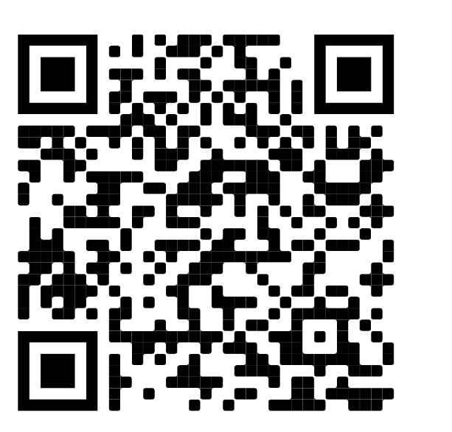
Thank you
For more information about this project, please use the QR code to visit the Digital Learning team’s HEPPP-funded Initiatives page.
https://emedia.rmit.edu.au/learninglab/content/heppp-funded-initiatives
Notes:
Thank you for listening, and if you would like more information – please use the QR code.

